Slide 1
HIV/AIDS and Health
Awareness and Wellness
26st June 2019
Kigali -Rwanda
Sabin Nsanzimana MD, MSc, PhD
HIV, STI & Viral Hepatitis Division Manager

Slide 2
AIDS is Caused by HIV
H
= Human
I
= Immunodeficiency
V
= Virus
The Virus causing AIDS

Slide 3
AIDS Defined
A
= Acquired = Get HIV from someone who is infected
= Immune = The body’s defense system which protects the body from disease
= Deficiency = Not having enough of something
= Syndrome = A group of symptoms associated with a particular disease
I
D
S

Slide 4
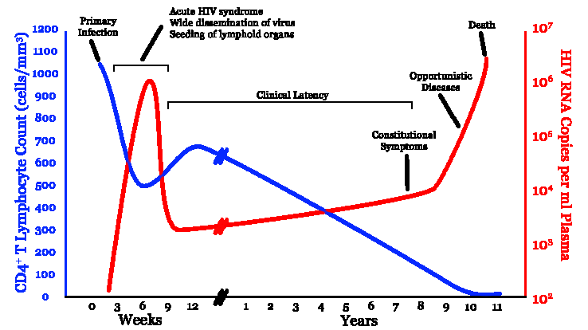
HIV Natural History
Source : Wikipedia

Slide 5
HISTORY
1981: 1st case of AIDS - LOS ANGELES
1983-1984:1st description of the virus (HTLV3) USA & France
1985: 1st tests /screening tests
1987: 1st ARVs « AZT »
1995-96: Tri-therapy (HAART) in High Income countries
End 1999: Access to ARVs in RWANDA & SS Africa
2002-2003 :Rapid scale up of HIV services in SSA
HIV was a death sentence =>Today HIV is a chronic disease

Slide 6
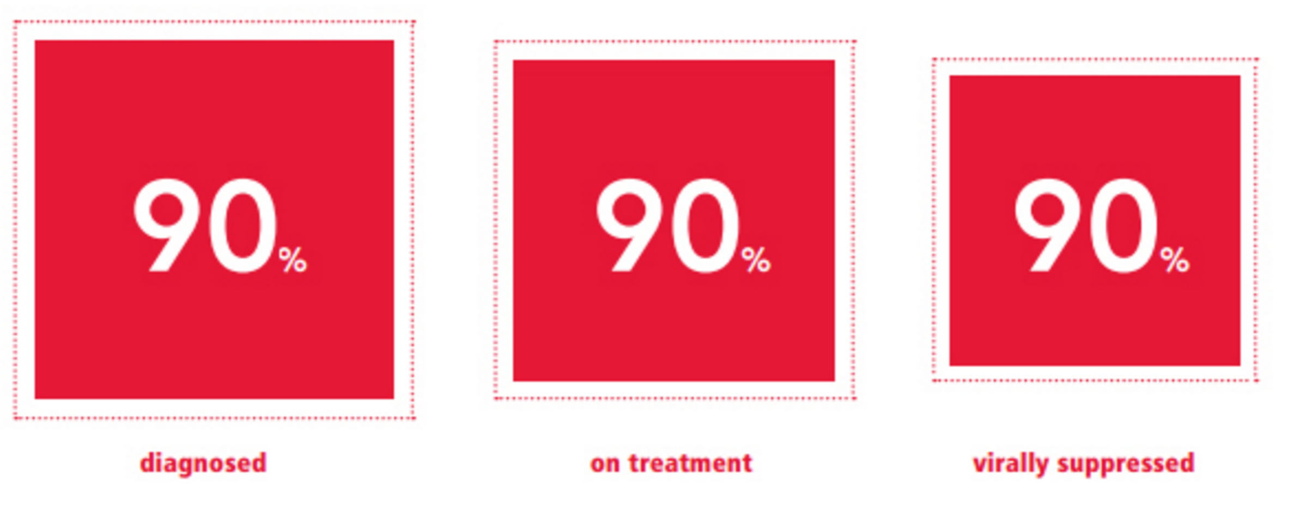
Program Priorities to Achieve Targets
HTC Transformation Case finding Self testing Linkages | Treat all HIV+ Differentiated Service Delivery Model (DSDM) | Adherence support Viral load monitoring Sensitization towards no sigma and discrimination

Slide 7
New HIV infections and HIV deaths over-time
2019 Spectrum Model for 2018
4,511 new infections
4,245 total deaths among PLHIV
(2,997 HIV-related deaths)
Notes:
Include actual number of total deaths vs actual new infections

Slide 8
Response to HIV in Rwanda
ART
Care & Support
Disc. Couple
No Stigma
Priority Pop.
Rwanda
HIV Response
VMCC
Condom
General Pop.
Blood Safety
Test Service
Unleashing potential
PMTCT
IEC/BCC

Slide 9
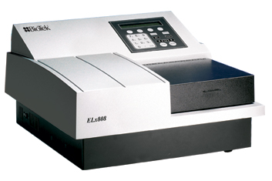
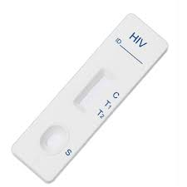
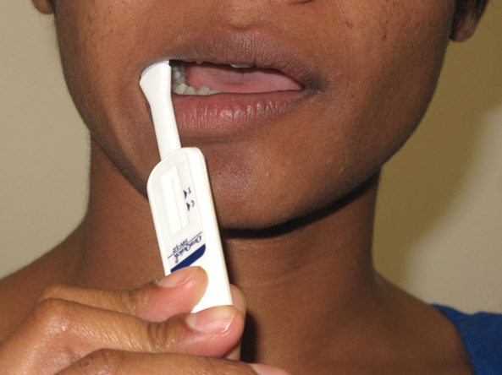
HIV Prevention in Rwanda
► HIV testing
Oral HIV Self Testing
HIV Testing Services

Slide 10
HIV Prevention in Rwanda
Mother-To-Child Transmission
► MTCT
(Mother-To-Child Transmission)
2000
10.8%
1.5%
45.8%
2019
(TRACNET/HMIS 2000-2019)

Slide 11
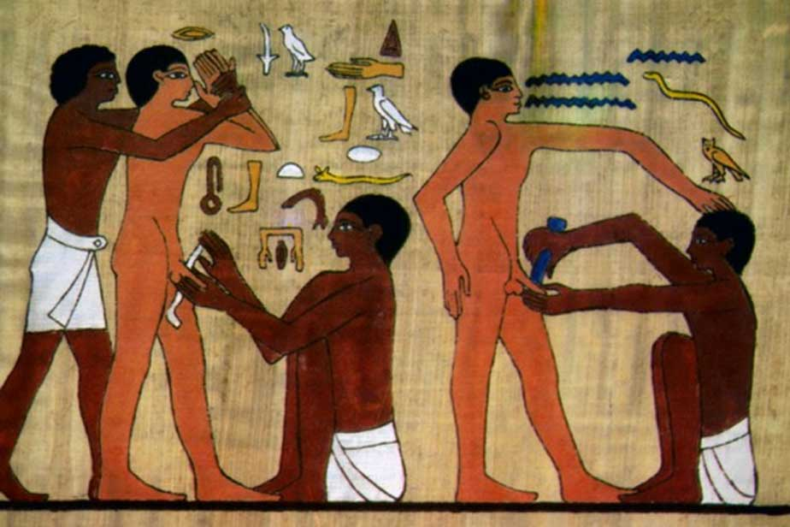
HIV Prevention
► VMMC
(Voluntary Medical Male Circumcision
Male circumcision reduces the risk of HIV transmission by 60%

Slide 12
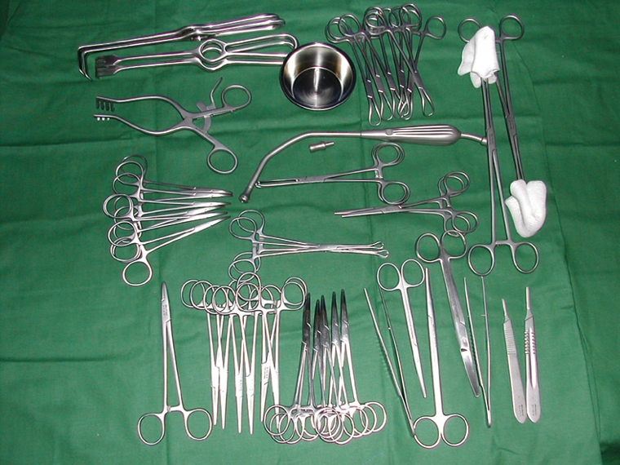
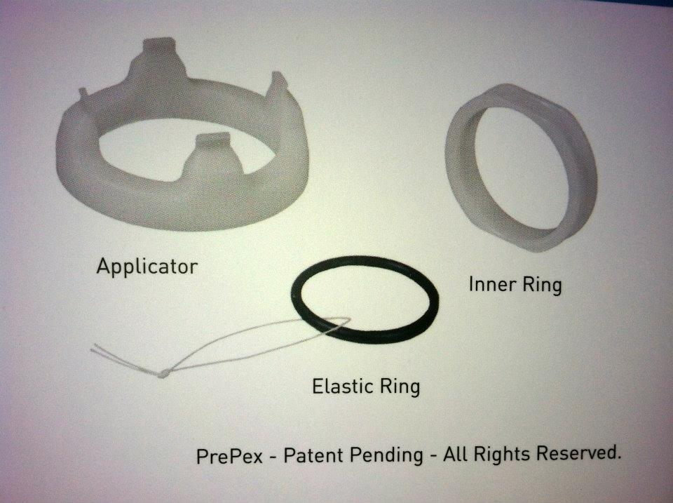
HIV Prevention in Rwanda
► VMMC
(Voluntary Medical Male Circumcision

Slide 13
The heart of Prevention
Use of condoms
The only multipurpose device, available NOW!
Triple protection method
Effective against HIV
Effective against STIs
Effective against unwanted pregnancy
No side effect, no resistance, inexpensive
Prefect for anal sex (male condoms)
Perfect for vaginal sex
Variety of sizes (49 mm for YP – 56 mm for gifted men), texture, shapes, color, scent, flavor, materials, designs and more
Notes:
“the condom remains the cheapest and highly effective method we have to stop the spread of HIV” M Sibibe

Slide 14
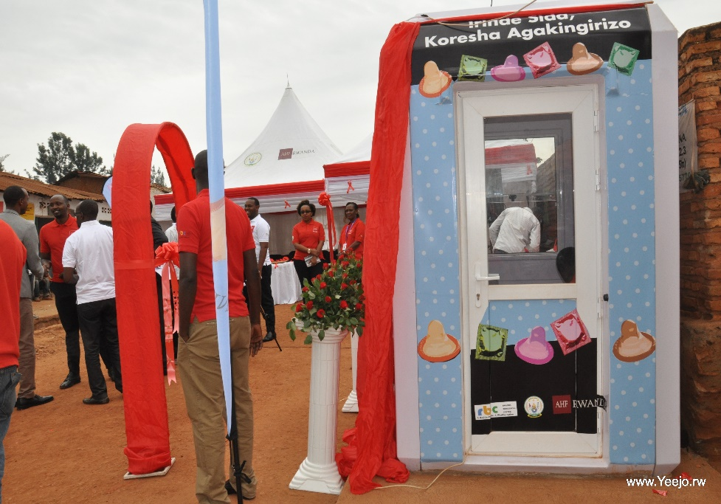
HIV Prevention in Rwanda
► Condoms
By 2018:
More than 1 million of condoms distributed through condoms kiosks

Slide 15
HIV Care & Treatment in RW.
► ARVs
85% by march 2019

Slide 16
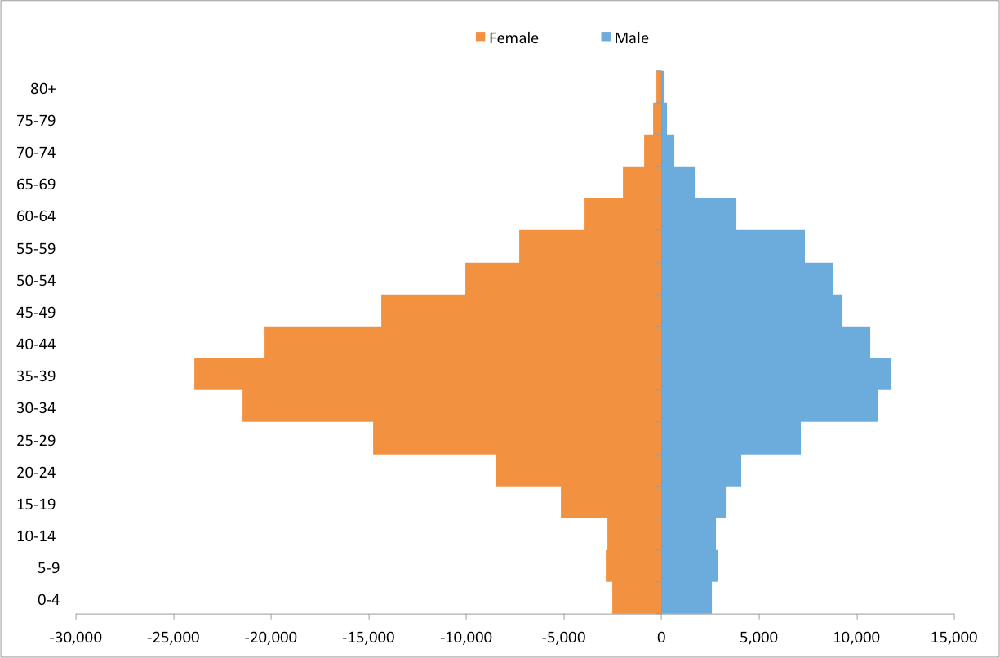
Demographics of PLHIV in Rwanda

Slide 17
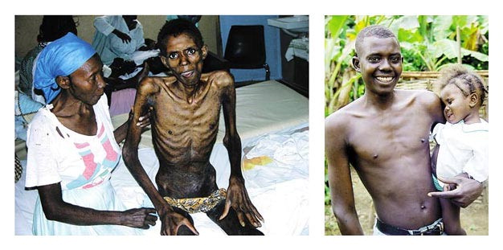
HIV Care & Treatment
► ARVs
(Antiretrovirals)
March 2003
6 months later
Kim JY, Farmer P. N Engl J Med 2006;355:645-647.
Saving Lives with ARVs and anti TB

Slide 18
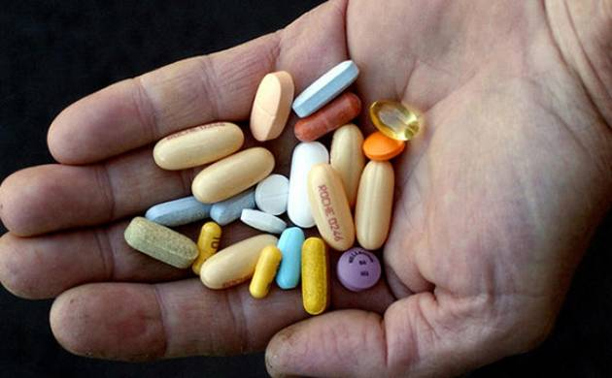
Treatment simplification
► ARVs
Future Innovations
Long-acting treatment
Pills burden
Single pill
Monthly drug pick ups
3 months drug pick up
6 months drug pick up

Slide 19
Conclusions
With the scale up of ART in Rwanda and globally; life expectancy of PLWH has increased
The WHO Global Health Observatory Repository estimates life expectancy in Rwanda at age 20 as an additional 45 years
35% gain in just 10 years

Slide 20
HIV Care & Treatment
► ARVs
(Antiretrovirals)
“People infected with HIV virally suppressed cannot sexually transmit the virus to others”
This is now accepted in the HIV/AIDS community as a result of accumulating evidence since the early 2000s.
Undetectable: VL (viral load) < 200 copies/ml

Slide 21
Framework of the HIV response in Rwanda
VISION 2020 towards 2050
EDPRS, now NSTP
HSSP
HIV NSP

Slide 22
Impact Mitigation: decrease stigma and discrimination
Sensitization against stigma and discrimination and auto-stigmatization of people affected and infected by HIV
Protection of rights of people infected and affected by HIV especially at the workplace and in schools
Provide gender-specific services targeted to young women and their particular vulnerabilities.

Slide 23
HIV interventions at working places
HIV services in Rwanda are integrated and accessible to everyone free of charge
HIV program work closely with Private sector federation to ensure HIV services at work stations
HIV status should not be a condition to get a job or other form of privilege deprivation in Rwanda

Slide 24
Sedentary Lifestyle (silent killer)

Slide 25
Sedentary Lifestyle ( Definition)
sitting or lying down (except when sleeping)¹. i.e spend large amounts at school, at work, readying, using a mobile phone/computer for much of the day, travelling or during leisure time (eg. watching TV).
Linked to negative health consequences² (causing premature death)
Evidence³ Ppl sitting more than 11hrs/day have 40% increased risk of dying within 3 yrs, compared with those who sitting for fewer than 4hrs/day. Ppl sitting for 8-11 hrs/day increased their risk of dying by 15%.
¹ Sedentary-behaviour, available on http://www.sedentarybehaviour.org/what-is-sedentary-behaviour/ [Online accessible 23.05.2017]
² Ann Intern Med. 2015;162(2):123-132. DOI: 10.7326/M14-1651] [Online accessible 23.05.2017]
³Arch Intern Med. 2012 Mar 26;172(6):500-1. doi: 10.1001/archinternmed.2012.209. [Online accessible 23.05.2017]

Slide 26
Sedentary Lifestyle (Consequences)
Strong evidence¹ show sedentary lifestyle and lack of physical activity is a risk factor for NCDs:
Diabetes
Heart disease
Cancer
→ You burn 30% more calories when standing than when sitting
¹Biswas et al. Sedentary Time and Its Association With Risk for Disease Incidence, Mortality, and Hospitalization in Adults: A Systematic Review and Meta-analysis, Ann Intern Med. 2015;162(2):123-132. DOI: 10.7326/M14-1651] [Online accessible 23.05.2017]

Slide 27
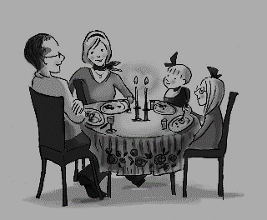
Bedtime
Sleeping
Phone/TV and family
Wake up
Dinner
≈ 4 hr
Bath, Breakfast
≈ 1/2hr
24 hours
Home to school, going to work
Phone/TV and family
≈ 1hr
School to home
Leaving from work
≈ 1hr
Office work
Office work
≈ 5 hrs
≈ 4hr
≈ 1hr
Meetings

Slide 28
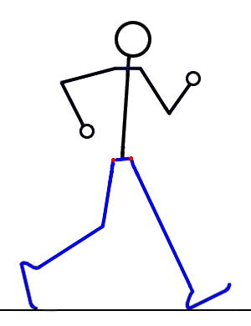
Sleeping
Phone/TV and family
Dinner
≈ 4 hr
Bath, Breakfast
≈ 1/2hr
24 hours
Home to school, going to work
Phone/TV and family
≈ 1hr
School to home
Leaving from work
≈ 1hr
Office work
Office work
≈ 5 hrs
≈ 4hr
≈ 1hr
Meetings

Slide 29
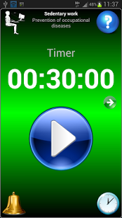
Sedentary Lifestyle (management at office)
Tips for sitting less, such as standing or moving around for 1- 3 min every half hour while you’re at work
Use the technology lots of apps on your phone/computer that will remind you
Standing when talking on the phone
Holding short and Stand-up meetings

Slide 30
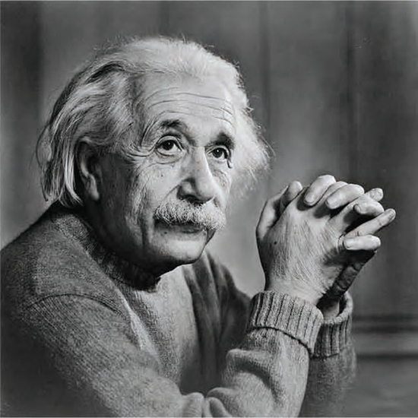
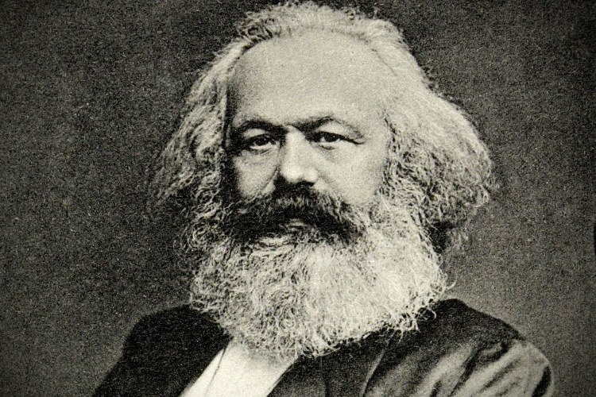
Bureaucracy ( their thoughts)

